Slide 1
Logical Statements,
Nested IF Statements, and Boolean Logic
CIS 300: Computer Information Systems
Professor Matt Thatcher

Slide 2
Start Tegrity!

Slide 3
Reminders
Since Last Class Did You...?
  Read through BB materials!!
    https://blackboard.louisville.edu/webapps/login
  Purchase the course textbook (MIS, 6th Edition by Effy Oz)
  Play with Tegrity Classes
    BB > Tegrity Classes - give it a try!
  Complete Lab 1 (Student Information Survey)
    BB > Tests
    Due: Fri, Jan 15 by 9:00pm
  Form teams to complete the Homework Assignments
    Assignments may be turned in as Office 2007 or 2003 format!
  Check email and BB announcements frequently
    BB > Announcements

Slide 4
Last Class
What is CIS 300 about?
  Learn how to build and use IS to solve business problems
What is a system?
  A set of components that work together to achieve a goal
  Inputs > Process > Outputs
What is an IS? A system that:
  Organizes, collects, and stores data (input and storage)
  Analyzes and manipulates the data (process)
  Generates information (output) used to solve problems and make decisions
  Examples? Amazon.com, Kroger's, Casinos, etc.
What are some common types of IS and IT?
  TPS, FAIS, ERP, CRM, SCM (we will dive into these later)
  Databases, data warehouses, decision support systems, expert systems, collaborative systems, telecommunications

Slide 5
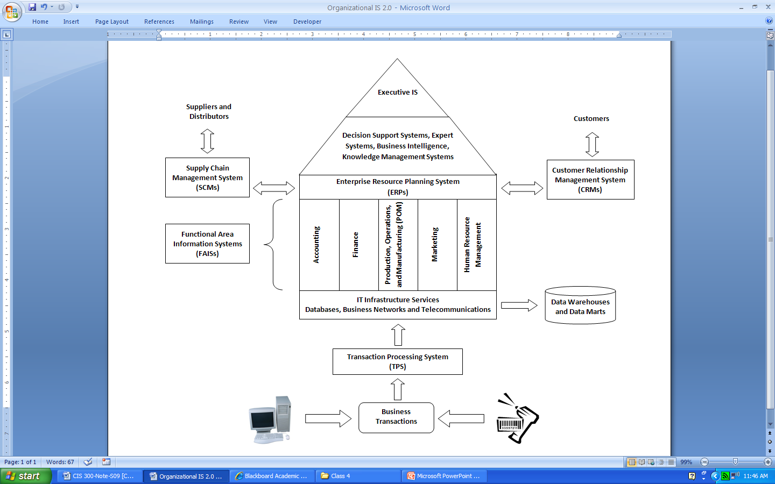
Last Class
Think about the organizational system
Think about organizational sub-systems
Where does CIS fit?
  How to build and use IS to support the business enterprise and coordinate the company’s subsystems
  Requires knowledge of technology, business, and people

Slide 6
MS Excel 2007 Overview
(BB > Tegrity Classes > MS Excel 2007 Overview)
Microsoft Excel 2007 Basics
  Tour the interface
  Entering and editing data
  Working with cells and ranges
  Working with sheets
  Defining names in worksheets
  Adding comments to cells
  Formatting worksheets
  Formulas and Functions
    Order of operations
    Cell references (absolute, relative, and mixed references)
    SUM, MIN, MAX, AVERAGE, COUNT, COUNTA
    Embedded functions
    Formula Auditing and Displaying/Watching Formulas

Slide 7
Homework Assignment 1
After today’s class complete Assignment 1
  Assignment 1 does not use MS Excel
    You should evaluate and create formulas without MS Excel
    Enter your responses in the Word template provided
  Due: Mon, Jan 25 by 11:30pm
  Turning in Assignment 1
    BB > Assignments > Submit Work Here > Homework 1
      Comments: put the name of each team member
      Attach Local File: upload your completed Assignment 1 in MS Word format
      Click Submit
      Check BB > My Grades to verify it was accepted (look for “ ”)

Slide 8
Lab 2
(College Admissions)
After today’s class complete Lab 2
  BB > Assignments > Labs > Lab 2
    The instructions, template, and the solution
  In Lab 2 you have been hired as an admissions officer by a small University in Kentucky. You are responsible for developing an MS Excel application that will determine which applicants to accept to the University for the upcoming Fall semester.
  I have posted a walkthrough of Lab 2 to Tegrity
    BB > Tegrity Classes > Lab 2: College Admissions

Slide 9
Today’s Reference Materials
This slide presentation
  BB > Course Documents > Course Slides
Additional Excel References
  Excel Bible 2007 (see schedule for chapter references)
  BB > Course Documents > Excel
    A whole series of MS Excel 2007 On-Line Tutorials (video- and picture-based)
    These are a very good reference for the basics features and functions
  And others – just search the web or Youtube.com for “Excel 2007 tutorials”

Slide 10
Evaluating Logical Statements
Logical statements return logical values
When you use an “=“ followed by a logical statement (e.g., 1>2 or A1<=A2) MS Excel:
  Evaluates the logical statement
  Determines whether the logical statement is a TRUE statement or a FALSE statement (TRUE and FALSE are logical values)
  Displays that result in the cell

Slide 11
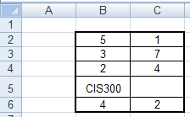
Evaluating Logical Statements
(Examples)
How will Excel evaluate these formulas?
  =B2>B3
  =B2+B3<>C2+C3
  =MIN(B2:C3)<MAX(B6:C6)
  =B5=“CIS300”
  =B4>=C2-C3
  =B2*C2=B2*B3
fffffffffffffffffffffffffffffffffffffffffffffffffff
  Answer: TRUE
  Answer: FALSE
  Answer: TRUE
  Answer: TRUE
  Answer: TRUE
  Answer: FALSE

Slide 12
The IF function
Returns one value if a condition (or logical statement) you specify evaluates to TRUE and another value if it evaluates to FALSE
Use IF to conduct conditional tests on values and formulas.
Syntax
IF(logical_test, result_if_true, result_if_false)
  Logical_test is any value or expression that can be evaluated to True or False
  Result_if_true is the value (or formula) that is returned if logical_test is True
  Result_if_false is the value (or formula) that is returned if logical_test is False.
Remarks
Up to 64 IF functions can be nested as result_if_true and result_if_false arguments to construct more elaborate tests.
When the result_if_true and result_if_false arguments are evaluated, IF returns the value returned by those statements

Slide 13
Use IF to conduct conditional tests on values and formulas using comparison operators
Operator Meaning
< less than
<= less than or equal to
= equal to
>= greater than or equal to
> greater than
<> not equal to
Examples: (two possibilities)
=IF(D35<100, 5, 0)
=IF(D35<100, 5%*D35,0)
=IF(C9>=$T$4,”You have won”, “”)
=IF(C9>=$T$4,”You have won”,) – see what happens here
=IF(C9=“Yes”,”Do it now”, “We have to wait”)

Slide 14
IF Statement
Example
  If Cell A1 says green, then the car can go; otherwise the car must stop
Solution
  =IF(A1="green","go","stop")
Notice
  How and when to use quotation marks!
  For example, in formulas:
    A1 and “A1” are not the same thing
    green and “green” are not the same thing

Slide 15


IF Function Example
 | A | B
1 | Actual Expenses | Planned Expenses
2 | 1500 | 1200
3 | 800 | 900
4 | 500 | blank
5 | 1000 | 1000
True
=IF(B4="blank","Error","OK")
Error

Slide 16
IF Function Example
 | A | B
1 | Actual Expenses | Planned Expenses
2 | 1500 | 1200
3 | 800 | 900
4 | 500 | blank
5 | 1000 | 1000
False
=IF(B5="B5","B5",B5)
1000

Slide 17
IF Function Example
 | A | B
1 | Actual Expenses | Planned Expenses
2 | 1500 | 1200
3 | 800 | 900
4 | 500 | blank
5 | 1000 | 1000
True
=IF(A2>B2,"Over Budget","On Plan")
Over Budget

Slide 18
IF Function Example
 | A | B
1 | Actual Expenses | Planned Expenses
2 | 1500 | 1200
3 | 800 | 900
4 | 500 | blank
5 | 1000 | 1000
True
=IF(A3<=B3, "Over Budget", "On Plan")
Over Budget (logic error, NOT a syntax error)

Slide 19
IF with SUM Example
 | A | B
1 | Actual Expenses | Planned Expenses
2 | 1500 | 1200
3 | 800 | 900
4 | 500 | blank
5 | 1000 | 1000
True
=IF(SUM(A2:A5)<5000,"OK","Not OK")
OK

Slide 20
SUM Example
 | A | B
1 | Actual Expenses | Planned Expenses
2 | 1500 | 1200
3 | 800 | 900
4 | 500 | blank
5 | 1000 | 1000
False
=IF(SUM(A2:A5)=SUM(B2:B5),"OK","Not OK")
Not OK

Slide 21
SUM with IF Example
 | A | B
1 | Actual Expenses | Planned Expenses
2 | 1500 | 1200
3 | 800 | 900
4 | 500 | blank
5 | 1000 | 1000
False
=SUM(IF(SUM(A2:A5)=SUM(B2:B5),1,0),99)
=99
0

Slide 22
The AND Function
Returns TRUE if all its arguments are TRUE
Returns FALSE if any argument is FALSE
Syntax
  AND(logical1,logical2,...)
  logical1,logical2,... are 1 to 255 conditions you want to test that can be either TRUE or FALSE
The arguments must evaluate to logical values such as TRUE or FALSE

Slide 23
AND Examples
Example
Formula | Description (Result)
=AND(TRUE,TRUE) | All arguments are TRUE (TRUE)
=AND(1+1=2,2+2=5) | One argument is FALSE (FALSE)
=AND(2+2=4,2+3=5) | All arguments evaluate to TRUE(TRUE)

Slide 24
The OR Function
Returns TRUE if any argument is TRUE
Returns FALSE if all arguments are FALSE
Syntax
  OR(logical1,logical2,...)
  logical1,logical2,... are 1 to 255 conditions you want to test that can be either TRUE or FALSE
The arguments must evaluate to logical values such as TRUE or FALSE

Slide 25
OR Examples
Example
Formula | Description (Result)
=OR(TRUE) | One argument is TRUE (TRUE)
=OR(1+1=1,2+2=5) | All arguments evaluate to FALSE (FALSE)
=OR(TRUE,FALSE,TRUE) | At least one argument is TRUE (TRUE)

Slide 26
IF with AND Example
 | A | B
1 | Actual Expenses | Planned Expenses
2 | 1500 | 1200
3 | 800 | 900
4 | 500 | blank
5 | 1000 | 1000
True
=IF(AND(A5=B5,A3<B3),"OK","Not OK")
OK
True
True

Slide 27
IF with AND Example
 | A | B
1 | Actual Expenses | Planned Expenses
2 | 1500 | 1200
3 | 800 | 900
4 | 500 | blank
5 | 1000 | 1000
False
=IF(AND(A2>A3,A3<A4),"OK","Not OK")
Not OK
True
False

Slide 28
IF with OR Example
 | A | B
1 | Actual Expenses | Planned Expenses
2 | 1500 | 1200
3 | 800 | 900
4 | 500 | blank
5 | 1000 | 1000
False
=IF(OR(A2<B2,A3=B3),"OK","Not OK")
Not OK
False
False

Slide 29
IF with OR Example
 | A | B
1 | Actual Expenses | Planned Expenses
2 | 1500 | 1200
3 | 800 | 900
4 | 500 | blank
5 | 1000 | 1000
True
=IF(OR(A2>B2,B4<>"blank"),"OK","Not OK")
OK
True
False

Slide 30
IF with AND and OR
 | A | B
1 | Actual Expenses | Planned Expenses
2 | 1500 | 1200
3 | 800 | 900
4 | 500 | blank
5 | 1000 | 1000
True
=IF(AND(OR(A2<B2,B4<>0),A5=B5),"OK","Not OK")
OK
False
True
True
True

Slide 31
The NOT Function
Reverses the value of its argument
Use NOT when you want to make sure a value is not equal to one particular value
Syntax
  NOT(logical)
  logical is a value or expression that can be evaluated to TRUE or FALSE
If logical is FALSE, NOT returns TRUE
If logical is TRUE, NOT returns FALSE

Slide 32
NOT Examples
Example
Formula | Description (Result)
=NOT(TRUE) | Reverses TRUE (FALSE)
=NOT(1+1<>2) | Reverses an equation that evaluates to FALSE (TRUE)
=OR(2>3,NOT(FALSE)) | At least one argument is TRUE (TRUE)

Slide 33
Lab 2
(College Admissions)
After today’s class complete Lab 2
  Lab 2 provides a lot of practice with Boolean Logic and IF statements
  I strongly recommend that you walk through this lab
    BB > Assignments > Labs > Lab 2
    BB > Tegrity Classes > Lab 2: College Admissions

Slide 34
Nested IF Statements

Slide 35
Nested If Statements
It is possible to nest multiple IF functions within one Excel formula. You can nest up to 64 IF functions to create a complex IF THEN ELSE statement.
Syntax
IF(condition1,result_if_true1,IF(condition2,result_if_true2,result_if_false2))
This would be equivalent to the following IF THEN ELSE statement:
IF condition1 THEN result_if_true1
ELSE IF condition2 THEN result_if_true2
ELSE result_if_false2
END IF

Slide 36
Example 1
Example 1 (Rule 1)
  If cell A1 says Green, the car can Go; if it is Red, it has to Stop; if it is Yellow it has to slow down; otherwise, the traffic light must be broken
Structure the Nested IF
  IF A1 = “Green” THEN “Go!”
  ELSE IF A1 = “Red” THEN “Stop!”
  ELSE IF A1 = “Yellow” THEN “Slow Down!”
  ELSE “The Traffic Light is Broken!!!”
  END IF

Slide 37
Example 1 Solution
What is the syntax used to implement this rule in MS Excel?
  =IF(A1=“Green","Go!",IF(A1=“Red","Stop!",IF(A1=“Yellow","Slow Down!","The Traffic Light is Broken!!!")))
You should enter this example is MS Excel and use Formula Auditing to see how Excel evaluates this formula

Slide 38
Example 2
Example 2 (Rule 2)
  If cell B1 (which contains a student’s total points out of a 100 scale) is greater than or equal to 90 then give her an A, if it is greater than equal to 80 and less than 90 then give her a B, if it is greater than equal to 70 and less than 80 then give her a C, if it is greater than equal to 60 and less than 70 then give her a D, and if it is less than 60 then give her an F
Structure the Nested IF
  IF B1 >= 90 THEN “A”
  ELSE IF B1 >= 80 THEN “B”
  ELSE IF B1 >= 70 THEN “C”
  ELSE IF B1 >= 60 THEN “D”
  Else “F”
  END IF

Slide 39
Example 2 Solution
What is the syntax used to implement this rule in MS Excel?
  =IF(B1>=90,"A",IF(B1>=80,"B",IF(B1>=70,"C",IF(B1>=60,"D","F"))))

Slide 40
Example 3
Example 3 (Rule 3)
  If cell A1 is less than 20, then multiply it by 1,
  If it is greater than or equal to 20 but less than 50, then multiply it 2,
  If it is greater than or equal to 50 but less than 100, then multiply it by 3,
  And if it is great or equal to than 100, then multiply by 4

Slide 41
Example 3 Solution
Structure the Nested IF problem
  IF A1<20 THEN A1*1
  ELSE IF A1<50 THEN A1*2
  ELSE IF A1<100 THEN A1*3
  ELSE A1*4
  END IF
Excel Syntax:
=IF(A1<20,A1*1,IF(A1<50,A1*2,IF(A1<100,A1*3,A1*4)))

Slide 42
Example 4
Example 4 (Rule 4)
  IF A1+B1 <= 4, return $20
  IF A1+B1 > 4 but <= 9, return $35
  IF A1+B1 > 9 but <= 14, return $50
  IF A1+B1 > 14, return $75

Slide 43
Example 4 Solution
Structure the Nested IF problem
  IF A1+B1<=4 THEN 20
  ELSE IF A1+B1<= 9 THEN 35
  ELSE IF A1+B1<= 14 THEN 50
  ELSE 75
  END IF
Excel Syntax
=IF(A1+B1<=4,20,IF(AND(A1+B1>4,A1+B1<=9),35,IF(AND(A1+B1>9,A1+B1<=14),50,75)))

Slide 44
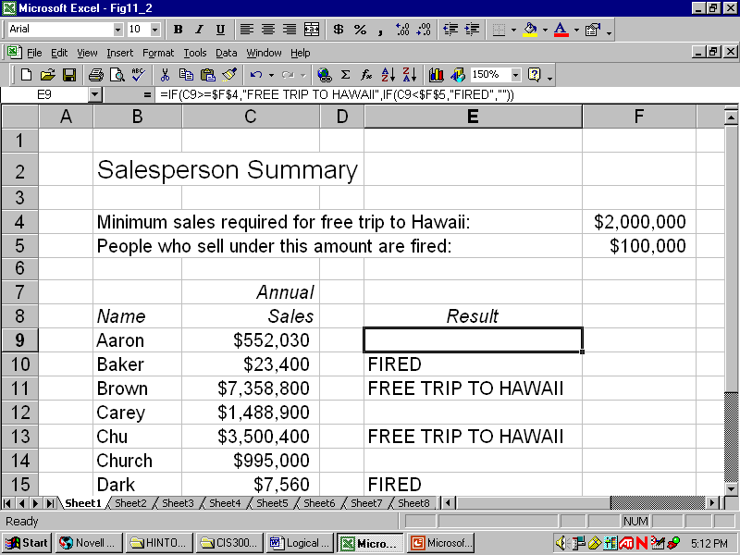
Try this Example
(Nested IF Statement)
Write down the formula that should be entered in cell E9 and copied to all other salespersons to provide the results shown?
=IF(C9>=$F$4, “FREE TRIP TO HAWAII”, IF(C9<$F$5, “FIRED”,””))
Notes:
Suppose the salespeople who sell under $100,000 are to be fired.
There are three choices for the cells in column E.
Cell E9 should contain
“free trip to Hawaii” if cell C9 contains a value of at least $2M
E9 should be blank if cell C9 contains a value between $100,000 and $2M.
“Fired” if cell C9 is under $100K

Slide 45
Nested If Statements
Figure out the logic and structure of the nested IF statement on paper first!
Then implement the formula in Excel syntax!

Slide 46
Structure the Lab 2 Nested IF
IF I2 = TRUE (rule 1) (note: do NOT use quotes around TRUE – in this case MS Excel recognizes it as a logical value, not text)
  “Check for data validity”
ELSE IF J2 = TRUE (rule 2)
  “Admitted per Rule 2”
ELSE IF K2 = TRUE (rule 3)
  “Denied per Rule 3”
ELSE IF L2 = TRUE (rule 4)
  “Admitted per Rule 4”
ELSE IF M2 = TRUE (rule 5)
  “Admitted per Rule 5”
ELSE IF N2 = TRUE (rule 6)
  “Admitted per Rule 6”
ELSE IF O2 = TRUE (rule 7)
  “Denied per Rule 7”
ELSE
  “Subject to further review”

Slide 47
Lab 2 Nested IF
Now implement this structure into MS Excel syntax

Slide 48
Practice, Practice, Practice
Creating and evaluating formulas
  Homework Assignment 1
  Lab 2
  Sample Test 1

Slide 49
The ISBLANK and ISNUMBER Functions
Syntax
ISBLANK(cell_reference)
Returns TRUE logical value if the cell is blank and FALSE otherwise
Syntax
ISNUMBER(cell_reference)
Returns TRUE logical value if the cell contains a number and FALSE otherwise

Slide 50
Stop Tegrity!

